Slide 1




Nurse Aide I Training Program Coordinator Orientation
NCDHHS/DHSR/HCPEC | Nurse Aide I Program Coordinator Orientation | October 2025
Notes:
Welcome to Nurse Aide I Training Program Coordinator Orientation, an orientation to the program coordinator role for NC state-approved nurse aide training programs. Active, involved program coordinators for nurse aide training programs are essential to the success of the programs. This presentation will provide information that will help you to become a successful program coordinator. Document any questions you have and reach out to your regional consultant for additional information..

Slide 2

Social Security Act
  Regulations:
  https://ncnar.ncdhhs.gov/naregulations.html
Medicare - Title XVIII
Medicaid - Title XIX
Omnibus Budget Reconciliation Act (OBRA) - 1987, 1989, 1990, 2016
42 USC 1395 i-3(c)
42 USC 1396(r)
CFR 42, Part 483
  CFR 483.35
  CFR 483.150 through 483.158
Regulations Governing Nurse Aide Training
NCDHHS/DHSR/HCPEC | Nurse Aide I Program Coordinator Orientation | October 2025
Notes:
There are several Laws that govern and regulate nurse aide training;
Medicare Title 42 - Public Health Chapter 4 - Centers For Medicare & Medicaid Services, Department Of Health And Human Services Subchapter G - Standards And Certification Part 483 - Requirements For States And Long-Term Care Facilities Subpart D - Requirements That Must Be Met by States and State Agencies: Nurse Aide Training and Competency Evaluation, and Paid Feeding Assistants.
Medicare Title 18 Section 1819 and Medicaid is Title 19 Section 1919. Both are part of the Social Security Act. Both include regulations for nurse aide training
OBRA of 1987 was implemented in 1989 and requires States to: (1) specify State-approved nurse aide training and testing programs which meet minimum standards established by the Secretary; and (2) maintain a registry of nurse aides who have successfully completed such programs, including specific findings of resident neglect or abuse or misappropriation of resident property involving such individuals.
42 U.S. 1395 i-3(c) Requirements for, and assuring quality of care in, skilled nursing facilities includes regulations for nurse aide training
42 U.S. 1396 (r) addresses requirements for nursing facilities and nurse aide training
Code of Federal Regulations (CFR)/Long-term Care Regulations are found at CFR 42, Part 483. Long term care regulations specific to Nurse Aide Training and Competency Evaluation Programs.
CFR 483.151, State Approval and Renewal of Nurse Aide Training and Competency Evaluation Programs, outlines the role of the State in reviewing and approving nurse aide training programs. A state may choose to offer nurse aide training programs itself or review and approve or disapprove nurse aide training and competency evaluation programs upon request. North Carolina has chosen the second option, to review and approve programs offered by entities throughout the state. The State may not grant approval of a nurse aide training program for a period longer than 2 years. Prior to the end of a 2-year approval period, the education consultant will review and reapprove the program for an additional 2 years if the regulations for nurse aide training programs are met.
CFR 483.152, Requirements for approval of a nurse aide training and competency evaluation program, includes requirements for nurse aide training programs. The requirements include minimum program hours, what content must be covered in a nurse aide training program, the role of and requirements for the program coordinator and instructor and the requirement for student proficiency in skills prior to providing services for residents. The education consultant reviews programs to ensure that the programs meet these requirements. The State-approved Nurse Aide I Curriculum addresses the curriculum content required by this regulation.
When a new nurse aide training program is approved by the State, it’s assigned a unique 5-digit program number. The program number is important in tracking the nurse aide training program and in working with the State competency testing vendor and the State Nurse Aide I Registry.
The NC Division of Health Service Regulation (DHSR) is the regulatory agency under the NC Department of Health and Human Services (DHHS). DHSR provides effective regulatory activities for the health, safety, and wellness of all North Carolinians. This includes consultation, training opportunities, and improved access to health care delivery systems. There are federal regulations that are applicable to the nurse aide programs under the Code of Federal Regulations which DHSR is charged to regulate.
CFR 483.154 establishes competency evaluation, and the testing vendor is overseen by the state,
CFR 483.156 establishes the Nurse Aide Registry.
CFR 483.158 establishes nurse aide training expenditures for students hired as nurse aides by a nursing home.

Slide 3


The Nurse Aide I
PROGRAM COORDINATOR
…is responsible for administering the Nurse Aide I (NAI) Program as approved by the State
…is the contact person for the Division of Health Service Regulation (DHSR)
…maintains the NAI Program in a manner consistent with federal regulations, state standards, and standards of educational practice
NCDHHS/DHSR/HCPEC | Nurse Aide I Program Coordinator Orientation | October 2025
Notes:
When a nurse aide training program is approved, the policies and procedures approved by DHSR are expected to be followed as the PC administers the program. If DHSR policies and procedures seem to conflict with directives from an employer or other regulatory entity, contact your regional consultant to assist in resolving any issues.
Federal regulations refer to the regulations for operating a nurse aide training program covered earlier in this presentation.
State standards, sometimes referred to as state guidelines or state requirements, assist all programs to meet the federal regulations in a consistent format.
Programs are expected to adhere to standards of educational practice such as a classroom being conducive to adult learning, providing an equitable course schedule for students, writing tests that are reliable and valid, applying the same grading standards to all students’ tests/assessments and adjusting teaching methods based on our changing environment, practices and requirements.

Slide 4
NC Division of Health Service Regulation
HEALTH CARE PERSONNEL EDUCATION AND CREDENTIALING SECTION
PROGRAM REGIONS
NCDHHS/DHSR/HCPEC | Nurse Aide I Program Coordinator Orientation | October 2025
Notes:
The Health Care Personnel Education and Credentialing Section (HCPEC) operates under state and federal regulations for unlicensed health care workers and their employers. The regulatory responsibilities include Nurse Aide I registry, training, and competency evaluation programs.
This map shows the different nurse aide training regions and their consultants. You may find this map on our web site (www.ncnar.gov) under the Education Office.

Slide 5

Web Resources
https://info.ncdhhs.gov/dhsr/hcpr/nat.html
https://www.nccommunitycolleges.edu/
https://www.nccommunitycolleges.edu/proprietary-schools
https://www.ncbon.com
https://credentia.com/test-takers/ncna
NCDHHS/DHSR/HCPEC | Nurse Aide I Program Coordinator Orientation | October 2025
Notes:
Web resources include the 5 websites listed.
https://info.ncdhhs.gov/dhsr/hcpr/nat.htmlis a direct link to the nurse aide training web page
https://www.nccommunitycolleges.edu/ the web site for the NC Community College System Office
https://www.nccommunitycolleges.edu/proprietary-office the web page for the NC Community College System Office of Proprietary Schools
https://www.ncbon.com/ web site for the NC Board of Nursing; search for nurse aide
https://credentia.com/test-takers/ncna web site for the vendor for the State competency evaluation exam

Slide 6

Program Coordinator Toolkit
Resources (DHSR Education Consultants, PCs from other state-approved NA I programs)
State approved Curriculum, Handouts, Certificates & Forms, PowerPoint Presentations
Program developed forms/documentation
DHSR approved NA I program proposal
DHSR list of equipment, materials, and supplies
Appropriate DHSR forms
NA I Candidate Handbook
Who to contact - Credentia
NCDHHS/DHSR/HCPEC | Nurse Aide I Program Coordinator Orientation | October 2025
Notes:
The education consultant for your region is your main resource. Do not hesitate to contact them with any questions.
Other program coordinators, your peers, may serve as valuable resources to each other.
The main written resource for nurse aide training is the state-approved Nurse Aide I curriculum which includes module scripts, handouts, PowerPoint presentations and references. Be sure to read the Nurse Aide I Training Requirements and Directions for Use of the Nurse Aide Curriculum found in the Introduction.
DHSR-approved forms may be found on our web site under the Education Office. Using these forms will assist you in meeting federal regulations and state requirements.
Another item in your tool kit to assist you in meeting federal regulations and state requirements are program-developed forms and documentation.
The Nurse Aide I new program proposal, submitted by each program and approved by DHSR, is your guide for policies and procedures to be implemented when offering a program.
The DHSR Basic Equipment and Supplies List includes items required for the classroom and practice lab.
DHSR manages the State contract with the company (vendor) that administers the state competency exam that leads to listing on the Nurse Aide I Registry. The vendor provides a candidate handbook to help the student prepare for the State competency exam. More information about the vendor and contact information for the vendor will be addressed later in this presentation.

Slide 7
Program Coordinator To Do’s
Complete Nurse Aide I new program approval paperwork, reapproval paperwork and other forms as required
Submit requests to DHSR for modification of program components prior to making changes
Be familiar with NC Health Care Personnel Registry Section and Credentialing website
Maintain regular contact with the region’s education consultant and meet with the consultant as required
Respond promptly when contacted by the region’s education consultant
Read Program Coordinator Resource information on our website: https://ncnar.ncdhhs.gov/saresources.html
NCDHHS/DHSR/HCPEC | Nurse Aide I Program Coordinator Orientation | October 2025
Notes:
New program approval documents are submitted to DHSR by a new program offered by an established entity, or a school without an established program such as a proprietary school awaiting licensure through the Office of Proprietary Schools and wants to offer nurse aide training or a nursing home without an established training program. Be sure to submit a completed form on the latest version of the form. If an incomplete or outdated form is received by DHSR, it will be denied approval.
Reapproval occurs every 2 years. The education consultant will contact Program Coordinator via email with links to required documents and instructions for reapproval. Reapproval forms are available on our web site. PCs are responsible for submitting or preparing student records for reapproval; your regional consultant will conduct observations of classroom/online instruction and proficiency checkoffs and inspect the equipment and supplies in the lab during the reapproval process.
Program Coordinators are required to request approval from a regional education consultant prior to implementing program modifications. The program modification form is available on the website. Complete the form if you wish to modify an existing state-approved Nurse Aide I Training Program. Complete the required supportive documentation with the program modification form. Sign the document and submit for review and approval by the education consultant.
It is not necessary to submit the program modification form for the following: Existing Training Program Forms for Faculty Approval and Removal, Clinical Site Approval, and Course Schedule and Supplemental Teaching Methodologies. If you are making temporary program modifications due to COVID-19, it is not necessary to submit the program modification form. Submit the COVID-19 forms instead..
Regional education consultants may be contacted by cellular phone, dhhs.nc.gov corresponding email address, DHSR.EducationConsultant@dhhs.nc.gov, or by FAX at 919-733-9764. Program coordinators who maintain regular contact and respond promptly when contacted by their region’s education consultant are more informed about updates by state and federal regulations as well as requests from vendors to improve outcomes for programs.
Regional Nurse Aide Training Program Meetings will resume in 2022. Program coordinators have an opportunity to attend and participate in select training opportunities conducted by the regional education consultant(s) either virtually or in person.

Slide 8

Forms for NA I Programs
NC HCPR: N.C. Nurse Aide I Registry Forms and Applications for State- Approved Training Programs
New Training Program:
Nurse Aide I Application
Geriatric Aide Application (Must Be An Approved Nurse Aide I Training Program)
Home Care Aide Application (Must Be An Approved Nurse Aide I Training Program)
Clinical Site Approval Form
Course Schedule and Supplemental Teaching Methodology Form
Faculty Approval Requirements Form
Faculty Approval Request Form
Basic Equipment and Supply List
Existing Training Program:
Reapproval Application
Nurse Aide I Refresher Application
Program Modification Application
Clinical Site Approval Form
Clinical Site Removal Form
Course Schedule and Supplemental Teaching Methodology Form
Faculty Approval Requirements Form
Faculty Approval Request Form
Faculty Removal Form
Basic Equipment and Supply List
NCDHHS/DHSR/HCPEC | Nurse Aide I Program Coordinator Orientation | October 2025
Notes:
Applicable Sections for Program Coordinators:
Announcements
Nurse Aide I (Curriculum, Credentia links, Power Point, and Federal Regulations)
Documents for Training Programs *Forms were last updated in October 2021. Please check the footer of the document to determine effective date*
New Training Program (Forms to be completed by NEW program applicants)*
Existing Training Program (Forms to be completed by EXISTING programs by program coordinators)*
Resources

Slide 9

Faculty
A current list of faculty will be maintained by DHSR
New faculty must be approved by DHSR prior to teaching. Use the appropriate form located on our website
New faculty must be oriented to the approved program policies, State curriculum and total program hours
Individuals no longer employed as NA I faculty will be removed from the DHSR database upon receipt of the appropriate form located on our website
NCDHHS/DHSR/HCPEC | Nurse Aide I Program Coordinator Orientation | October 2025
Notes:
It is the responsibility of the Program Coordinator to ensure all Faculty maintain an active/unencumbered Registered Nurse license approved for practice in North Carolina.
Nurse aide students must be under the direct supervision of a State-approved registered nurse per 42 CFR §483.152.

Slide 10
Faculty Orientation & Training
Faculty will be oriented to approved program policies; State curriculum & total program hours required
Approved policies & State curriculum will be reviewed upon hire, at least annually & periodically thereafter as necessary
New directives & program changes from DHSR will be immediately introduced to all by faculty trainings
Documentation of orientation & training activities, including attendance, will be maintained & available for review by the State
NCDHHS/DHSR/HCPEC | Nurse Aide I Program Coordinator Orientation | October 2025
Notes:
The Program Coordinator will review the following at minimum with all faculty upon hire and annually or as needed as soon as released:
Explain federal regulations and state standards governing nurse aide training to faculty
Explain most current State-approved Nurse Aide I curriculum and how to follow the curriculum to faculty including Nurse Aide I Training Requirements and Directions for Use of Nurse Aide Curriculum found in the curriculum introduction,

Slide 11

The North Carolina State-approved Nurse Aide I Training Program Curriculum is located at: NC DHSR HCPEC: State-Approved Nurse Aide I Curriculum
STATE-APPROVED CURRICULUM
NURSE AIDE I TRAINING PROGRAM
July 2024 Revision
North Carolina Department of Health and Human Services
Division of Health Service Regulation
Health Care Personnel Education
and Credentialing Section
NCDHHS/DHSR/HCPEC | Nurse Aide I Program Coordinator Orientation | October 2025
Notes:
The North Carolina State-approved Nurse Aide I curriculum is the primary instructional resource which includes teaching guides, curriculum content, PowerPoint presentations, and classroom handouts and activities. Lecture, cooperative learning, individual or class projects, group presentations and required lab activities are also considered forms of primary instruction.
Nurse Aide I training programs are required to use the most current version of the North Carolina State-approved Nurse Aide I curriculum provided by the North Carolina Division of Health Service Regulation.

Slide 12

State-Approved NAI Curriculum
Training requirements & directions for use in Preface
Curriculum presented in Modules AA – W and Z
Curriculum pages include objectives, content, resource materials/teaching tips/activities/notes
Appendix A Instructional Objectives & Performance Checklist Summary
Threads of Care
NCDHHS/DHSR/HCPEC | Nurse Aide I Program Coordinator Orientation | October 2025
Notes:
The State-approved Nurse Aide I Curriculum includes the following:
Training requirements & directions for use are in the Introduction; this information will serve as a reference as you become familiar with the role of the program coordinator
Be sure to click “Introduction” on https://info.ncdhhs.gov/dhsr/hcpr/curriculum/index.html for great descriptions of the requirements for the state-approved Nurse Aide I program. The Nurse Aide I Training Requirements begin on page i. Directions for Use of the Nurse Aide I State-approved Curriculum begin on page iv.
The teaching guides will give you the required information as well as additional material to incorporate components to your lesson plans such as the “Teaching Tips.” Activities are required and Teaching Tips are optional.
Curriculum content is presented in Modules AA – W and Z; each program decides the order of presentation for the modules
Curriculum pages include objectives, content, resource materials/teaching tips/activities/an area for instructor notes
Appendix A, which is the Instructional Objectives & Performance Checklist Summary; required documentation for student files to show skills proficiency.
Threads of Care are those concepts that are interwoven within skills steps and are meant to expand and build upon the foundation concepts taught in Modules AA – W. The Threads of Care begin on page 1-Z.

Slide 13
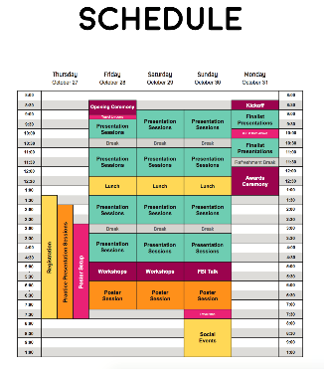


DHSR-Approved NA I Program Application
Demographics page
Statement of understanding
Philosophy & program objectives
Class schedule
Supplemental teaching methodologies/instructional resources in place (& less than 5yrs old)
List of equipment, materials, supplies (using DHSR Basic Equipment & Supply List)
Classroom, laboratory, clinical sites, total hours & content
Faculty applications (meets requirements) & DHSR-approved list of faculty
Faculty orientation & annual in-service processes
Set of policy statements
NCDHHS/DHSR/HCPEC | Nurse Aide I Program Coordinator Orientation | October 2025
Notes:
Here you see the items included in the Nurse Aide I New Training Program – Initial Application.

Slide 14

Instructor Student Ratios
Classroom __ instructor(s): __ student
Laboratory __ instructor(s): __ students
Clinical _____ instructor(s): __ students
(Maximum of 1:10 in clinical setting)
NCDHHS/DHSR/HCPEC | Nurse Aide I Program Coordinator Orientation | October 2025
Notes:
One instructor can teach up to the number of seats available in a classroom., The ratio of instructor to students in the lab will be determined after your consultant reviews the lab during a site visit.

Slide 15

Class Schedule
Includes each State curriculum module letter, module name, skill name, and skill number with corresponding class hours, lab hours & clinical hours to guide the learning process
Assures students under direct RN supervision DHSR approved
The hours for class, lab, clinical and total hours on the schedule must correspond to the hours on the approved application
One class hour equals sixty minutes of instruction
Class schedule and the corresponding class roster and attendance record will be maintained in a class file for each course
Class schedules shall be available to the state for review upon request
NCDHHS/DHSR/HCPEC | Nurse Aide I Program Coordinator Orientation | October 2025
Notes:
The class schedule includes what will occur on each day of the course.

Slide 16
Class Schedule
A minimum of 16 clock hours of instruction in the following defined areas prior to resident contact are required (Modules A – G):
communication & interpersonal skills
infection control
safety/emergency (including relief of choking)
promoting residents’ independence
respecting residents’ rights
Absences that occur during this defined instruction must be made up hour-for-hour prior to resident contact & documented
NCDHHS/DHSR/HCPEC | Nurse Aide I Program Coordinator Orientation | October 2025
Notes:
42 CFR §483.152 mandates at least 16 hours of training in the following areas prior to any direct contact with a resident:
communication and interpersonal skills
infection control
safety/emergency procedures including the Heimlich maneuver
promoting residents’ independence
respecting residents’ rights
This information is covered in Modules A through G of the North Carolina State-approved Nurse Aide I training program curriculum.

Slide 17

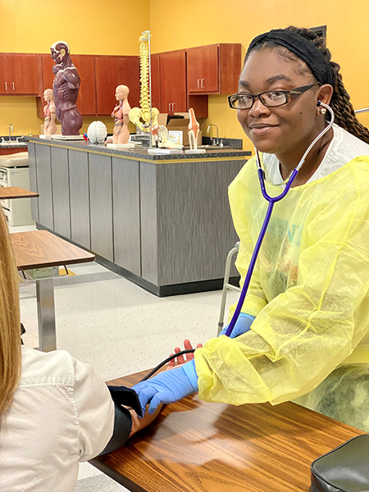

Supplemental Teaching Methodologies
Strategies used in the classroom or lab that go beyond traditional lecture
Examples:
  Role-play
  Case studies
  Crossword puzzles
  Learning games and/or activities
NCDHHS/DHSR/HCPEC | Nurse Aide I Program Coordinator Orientation | October 2025
Notes:
Talking point:
To find additional teaching methodologies, search the internet using the terms, teaching methodologies or teaching strategies, in your favorite search engine. You can narrow your search by entering the terms adult teaching methodologies or adult teaching strategies. Don’t overlook teaching strategies for k-12. You will discover that some of them will be adaptable for use with an adult audience.

Slide 18

Instructional Resources
Current (no older than 5 years)
Examples:
  Student textbook and workbook
  Videos
  Computer assisted instruction
  Online Activities
NCDHHS/DHSR/HCPEC | Nurse Aide I Program Coordinator Orientation | October 2025
Notes:
Any instructional resource must be less than 5 years old.
The main instructional resource for Nurse Aide I training is the NC State-Approved Nurse Aide I Curriculum.
Supplemental instructional resources must be approved by DHSR.

Slide 19
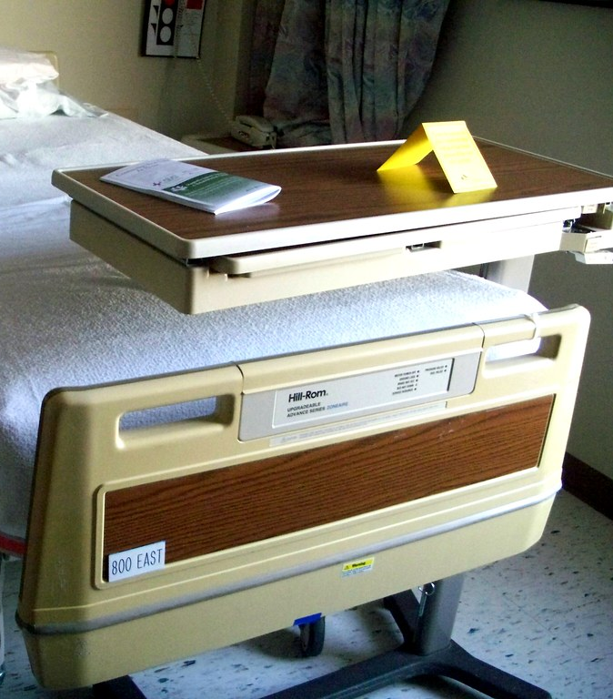
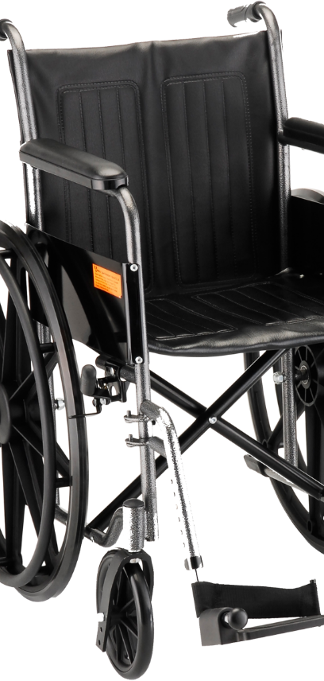

Equipment, Materials & Supplies
Faculty & students must have access to equipment, materials & supplies in specified numbers & in working order noted on the most current Basic Equipment Supply List
The most current version is located on DHSR website: https://ncnar.ncdhhs.gov/saappforms.html
NCDHHS/DHSR/HCPEC | Nurse Aide I Program Coordinator Orientation | October 2025
Notes:
Note that on the Basic Equipment and Supply List, “as needed” is defined as having sufficient quantity of supplies appropriate to the number of students that will permit class objectives to be met by instructor demonstration, student practice and proficiency demonstration by students. It does not mean “optional” like some of the other items listed such as a Geri chair, mechanical lift etc.
Each laboratory will contain the items listed on the New Training Program – Basic Equipment and Supply List and will adhere to 42 CFR §483.90

Slide 20
Classroom
Description & diagram of each classroom must be approved by DHSR before use
May not change or add classrooms without prior approval from DHSR
Accommodates adult learners comfortably
Presence of proper heating, lighting & ventilation
Includes – instructor desk, student tables & chairs, AV equipment including laptop/computer, and traditional dry erase board
NCDHHS/DHSR/HCPEC | Nurse Aide I Program Coordinator Orientation | October 2025
Notes:
An interactive whiteboard, such as a SMART board, may be used in place of a traditional dry erase board

Slide 21
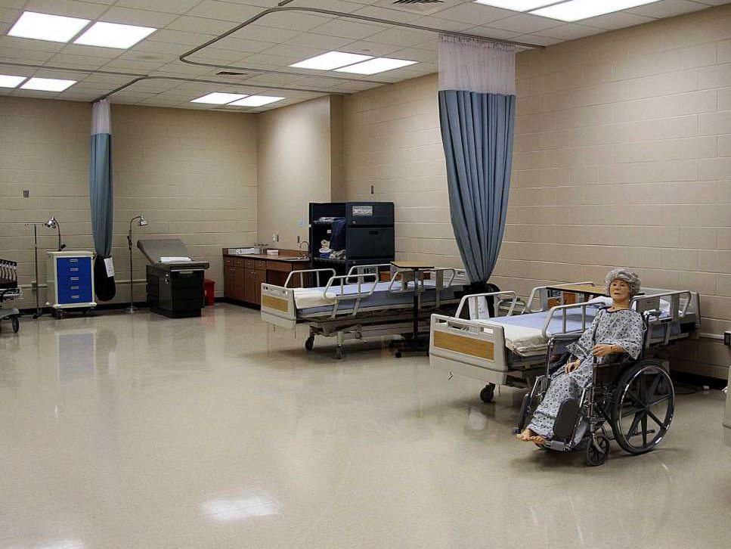
Laboratory
Description & diagram approved by DHSR before use
May not change or add laboratory settings without prior approval from DHSR
Minimum of 100 square feet for one bed or 80 square feet per bed for two or more beds
Set up is similar to a resident’s room
Includes – sink with hot/cold running water, full privacy curtains that hang from the ceiling and move freely, resident care unit (working bed with side rails, bedside table, chair, trashcan, over-bed table & simulated call system)
NCDHHS/DHSR/HCPEC | Nurse Aide I Program Coordinator Orientation | October 2025
Notes:
A laboratory is required to have a minimum of one bed for every 10 students See the BESL.
Full privacy is interpreted by federal regulations as “total visual privacy.” Total visual privacy is accomplished in the lab by having a full privacy curtain hanging from the ceiling that, along with the wall(s), provides 360º of privacy for each bed.
As the program coordinator, you will be responsible for making sure each laboratory will be designed and equipped in accordance with 42 CFR §483.90 and will contain the required number of supplies reflected in the New Training Program – Basic Equipment and Supply List.

Slide 22
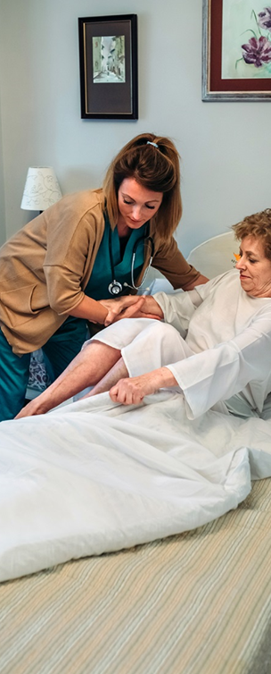
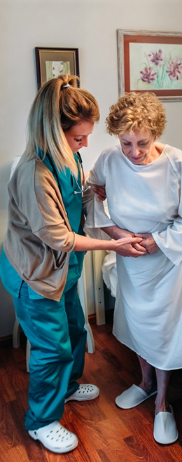
Clinical Sites
Clinical sites must be approved by DHSR before use
Clinical Site Approval Form must be submitted to DHSR
Must provide learning experiences for students consistent with course objectives
NCDHHS/DHSR/HCPEC | Nurse Aide I Program Coordinator Orientation | October 2025
Notes:
It is the Program Coordinator’s responsibility to visit and evaluate clinical sites to ensure the students will have ample opportunity to perform the skills listed on Appendix A.
The instructor must evaluate the student’s performance of at least 15 state-designated *starred* skills and any non-starred and school specific skills from Appendix A performed in the clinical setting.
Use the most up-to-date Clinical Site Approval form on our website.
Your regional consultant will be able to let you know if a facility is eligible to be a clinical site.

Slide 23



While in Clinical
Students must be under the direct supervision of an RN instructor approved by DHSR
Students must wear a nametag that includes student’s name, followed by “Nurse Aide I Trainee” or “Nurse Aide I Student”
NCDHHS/DHSR/HCPEC | Nurse Aide I Program Coordinator Orientation | October 2025
Notes:
The program coordinator is responsible for making sure students are supervised during practical training to ensure students demonstrate the knowledge and skills required to perform nurse aide tasks safely; students providing care for residents must be under the direct supervision of a DHSR-approved registered nurse per 42 CFR §483.152.
The student nametag is to be worn facing outward at all times. For further information about nametags, refer to the North Carolina Board of Nursing Chapter 90 Article 37 Badge Law, License Required and Exceptions Students cannot perform any services to residents for which they have not been trained and found proficient by the instructor per 42 CFR §483.152.
The instructor-to-student ratio for clinical cannot be greater than 1:10 per 21 NCAC 36. 0318.
Whatever you decided was YOUR proficiency statement affects how you grade in clinical, too. Many programs choose to use a clinical evaluation form to make sure the student is held accountable for their initiative, judgement, punctuality, dress code, etc. along with their skill performance.

Slide 24
Skills Performance
Information about skills performance checklists, performance requirements, and documentation is in the State-approved Curriculum
Skills requirements for lab & clinical are in the Guidance of the July 2024 State Approved Nurse Aide I Curriculum
Appendix A Skills Performance Checklist Summary used in lab & clinical, is located at: https://info.ncdhhs.gov/dhsr/hcpr/curriculum/index.html
Skills checklists for each skill listed on the Appendix A form are developed and provided to students by each program
NCDHHS/DHSR/HCPEC | Nurse Aide I Program Coordinator Orientation | October 2025
Notes:
As the program coordinator, you are responsible for creating a skill performance checklist for each skill. Identify critical steps by using bold lettering.
The instructor uses the appropriate skill checklist, observes a student’s performance of the skill and then actively checks-off each skill step on the sheet. The instructor does not prompt, cue, or assist the student. Based on the program’s definition of proficiency, the student either passes the skill and is found proficient or does not pass the skill. Students who pass the skill must continue to independently practice the skill correctly over-and-over in order to achieve long-term retention of skill performance. Students who fail proficiency check-offs should repeat guided practice and independent practice, and then be checked-off again, per program policy. Per federal regulations, students may not perform a skill on a resident, in the clinical setting, until the student is found proficient in that specific skill.
The goal is for the student to develop muscle memory for each skill set through guided practice, independent practice, and then repeat demonstration to the instructor.

Slide 25

Test Security
The instructor is responsible for ensuring and maintaining the integrity and security of the classroom/laboratory testing process and storage
NCDHHS/DHSR/HCPEC | Nurse Aide I Program Coordinator Orientation | October 2025
Notes:
At least two versions of each test are required. The version should be identified on the test. Students should date the test using month, day and year.
Written testing materials should be stored onsite in a locked cabinet. The location of the locked cabinet will be approved by DHSR.
Have you checked security of your online tests?
Is your browser locked down? If the browser is locked down during a test, students will be unable to search the internet for their test questions and/or answers using a search engine such as Google.
Do you have a proctoring service while testing online?

Slide 26
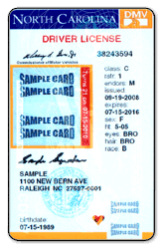


Student Identification Policy
Each student’s identity must be verified and documented according to the program’s policy approved by DHSR prior to the start of a State-approved NA I course.
What does your policy state?
Student identification will be based on the following:_______________.
NCDHHS/DHSR/HCPEC | Nurse Aide I Program Coordinator Orientation | October 2025
Notes:
Later, when students are ready for competency testing, they will be required to show two forms of identification such as:
A current, government issued signature-bearing, picture identification card, such as a driver’s license, passport, DMV identification card, or military ID; and,
A signed, non-laminated US government-issued social security card
The IDs required for competency testing may be different from the IDs requested prior to starting the class

Slide 27

Student Records Components
Completed instructional objectives & skill performance checklist summary (Appendix A)
Attendance records (dates of absences, material/clinical missed, dates of make-up)
Tests or answer sheets labeled with test version (date)
Test scores (calculated correctly)
Verification of student identity and documentation of verification
NCDHHS/DHSR/HCPEC | Nurse Aide I Program Coordinator Orientation | October 2025
Notes:
Documents maintained in the student record allow the regional consultant to confirm that a program meets federal regulations and state requirements; the adage, if it’s not documented, it’s not done applies, to student records
Consider having a checklist of the required items at the front of each student record to make sure these items are in the student file.
At a minimum, the following documents must be retained in the student record :
Completed Appendix A Instructional Objectives & Skill Performance Checklist Summary
For students who drop or withdraw from the program, Appendix A should be completed up to the date of the drop or withdrawal
Scored answer sheets or tests, only if test answers are documented on a test, and labeled with test version (date)
Test scores documented on an answer sheet or test and calculated correctly
If you wish to keep social security numbers out of the student records, you may contact your regional consultant who can provide you with a sample verification of a student identity form
Maintain a class file to keep with the student records for each course completed that includes class schedule and master attendance roster with the beginning and ending dates, instructor name, student names, and hours for each day.

Slide 28

Attendance Policy
Successful completion of program is dependent upon the student completing a minimum of __ clock hours (your total program hours minus those your program allows by policy for absence) of instruction
NCDHHS/DHSR/HCPEC | Nurse Aide I Program Coordinator Orientation | October 2025
Notes:
The minimum clock hours are determined by each program upon initial approval and any subsequent approved modifications.
All missed classroom, laboratory and clinical experiences must be made up for students to complete the Nurse Aide I training program.
If a student missed a test, they should be given a different test version than the rest of the class took.
When considering the number of hours a student may be absent from a nurse aide training program, take into account that the nurse aide in a nursing home may perform up to 90% of the hands-on care provided to a resident, depending on the study you read. Providing safe care for residents is critical to the role of the nurse aide. Being a nurse aide creates stress on the nurse aide because of what is at risk for both them and their own residents if they fail. Hours of absence should be kept to a minimum so the nurse aide student has the opportunity to learn how to provide safe and competent care for residents.

Slide 29

Attendance Policy
All missed classroom, laboratory & clinical experiences will be made up and documented for the student to complete the Nurse Aide I Training program
NCDHHS/DHSR/HCPEC | Nurse Aide I Program Coordinator Orientation | October 2025
Notes:
When an absence occurs, the following must be documented and placed in the student record:
Date absence occurred
Content in class/lab/clinical that was missed
Date content was made up or completed
Note: The makeup work of a student does not need to be hour for hour since teaching a single student may take less time than teaching a group of students..
HOWEVER, absences that occur during the defined instruction (16 hours Modules A-G) must be made up hour-for-hour prior to resident contact & documented. (referenced on slide 16)
- communication & interpersonal skills
- infection control
- safety/emergency (including relief of choking)
- promoting residents’ independence
- respecting residents’ rights

Slide 30
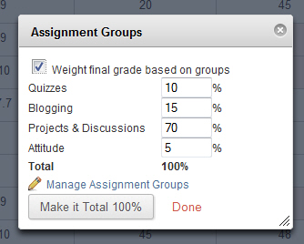
Theory Grade Components
The Program Coordinator is responsible for developing assessments, quizzes and tests, at a minimum, to determine the Theory Grade
EXAMPLE
NCDHHS/DHSR/HCPEC | Nurse Aide I Program Coordinator Orientation | October 2025
Notes:
Instructors should not “throw out” test questions. If there are issues with the test questions (i.e., students repeatedly missing the same question) it is the responsibility of the PC to investigate and revise as appropriate.

Slide 31
Passing Grade - Theory
To successfully complete the NA I Program, the student must receive a grade of 75 or higher in the theory component according to the program policy approved by DHSR.
The theory grade may be derived based on any of the following components: tests, a comprehensive exam, quizzes, homework/activities, a project, etc. You, the PC, will identify the percentage each component contributes to the final theory grade.
70%
40%
20%
100%
10%
NCDHHS/DHSR/HCPEC | Nurse Aide I Program Coordinator Orientation | October 2025
Notes:
The theory grade must be approved by DHSR during the approval process. Each component must include a weighted percentage and when totaled, the percentage must equal 100%.

Slide 32
Passing Grade – Theory Example
IMPORTANT- Calculate each student’s grade correctly
Based on your initial approval, for example, the student must achieve a minimum score of 80.
Theory Component | Weight | Grade(s) | Weight / 100 | Add this column
7 Quizzes | 70 % | 90,80,75,100 90,65,100 | 600/7=85.7 85.7 x 0.7 | 60
1 Project | 10 % | 100 | 100 x 0.1 | 10
Final Exam | 20 % | 84 | 84 x 0.2 | 17
Total Weight | 100% |  | FINAL GRADE | 87
NCDHHS/DHSR/HCPEC | Nurse Aide I Program Coordinator Orientation | October 2025
Notes:
It’s important we calculate each student’s grade correctly. Let’s do an example.
Based on an initial approval, you’ve requested 7 quizzes to be 70% of the total grade, 1 project to be 10% of the total grade, and the Final Exam to be 20% of the total grade. The student will achieve a minimum score of 80. If your policy states for your instructors to round up, round down or don’t round at all, don’t forget to double check calculation of final theory grade.
First step: Quizzes grades (90, 80, 75, 100, 90, 65, 100)= 85.7 x 0.70=59.99
Second step: Project grade 100 x 0.10= 10
Third step: Final Exam grade 84 x 0.20=16.8
Final step: Add 59.99+10+16.8= 86.79
FINAL GRADE: 87
It is important to check, recheck, and check again student grades. You would hate for a student not to pass because of a math error.

Slide 33

Passing Grade - Practical
To pass the practical (laboratory & clinical) portion of the NA I program, the individual will be proficient in demonstrating skills defined by DHSR. Proficiency is defined as the ability to perform a skill in a competent & safe manner. Laboratory and clinical are pass/fail.
What is your approved proficiency statement?
Each program-created skill
checklist must contain
proficiency requirements
that are evident to both
students and instructors.
NCDHHS/DHSR/HCPEC | Nurse Aide I Program Coordinator Orientation | October 2025
Notes:
The defined proficiency statement in your DHSR approved application must be followed.
Students cannot perform any services to residents for which they have not been trained and found proficient by the instructor per 42 CFR §483.152.

Slide 34
Passing Grade - Practical
The program policy for skills proficiency must be one of the following:
  as a percentage of steps performed
  In order to be deemed proficient, the student must demonstrate ___ percentage of steps for each skill correctly;
or as critical steps
  In order to be deemed proficient, the student must demonstrate each predetermined critical step of the skill correctly
or as a combination of both
  In order to be deemed proficient, the student must demonstrate ___ percentage of steps for each skill and demonstrate each predetermined critical step of each skill correctly).
NCDHHS/DHSR/HCPEC | Nurse Aide I Program Coordinator Orientation | October 2025
Notes:
For example, if your proficiency statement says the student will perform 100% of ALL critical steps and 80% of the noncritical steps, then you must follow that proficiency statement for ALL skills.

Slide 35
Let’s Look at Handwashing
with 80% Proficiency
10 total steps (3 critical and 7 noncritical steps)
80% of 7 noncritical steps= 100 x 80% = 0.8 x 7 steps = 6 (5.6 round up)
Student must perform all 3 critical steps and
Miss no more than miss 1 noncritical step to meet the approved proficiency statement of 80%
NCDHHS/DHSR/HCPEC | Nurse Aide I Program Coordinator Orientation | October 2025
Notes:
Let’s look at Handwashing. If there are 10 total steps for this skill and 3 critical steps, then the student must perform 80% of the 7 noncritical steps and all the critical steps to be proficient for this skill. So, to figure 80% of 7 steps, you would multiple 100 x 80%= 0.8 x 7 steps = 6 (5.6 rounded up) steps must be performed perfectly. Based on this, the student must pass all critical steps and miss only 1 noncritical step for the entire skill.

Slide 36

Monitoring Student Records
  Program Coordinator will continuously monitor student records for accuracy
  Monitoring and changes based on monitoring will be documented
  System for monitoring student records for accuracy will be in place and available to the State upon request
NCDHHS/DHSR/HCPEC | Nurse Aide I Program Coordinator Orientation | October 2025
Notes:
The student records should be monitored for accuracy assuring inclusion of the Skill Performance Checklist Summary (Appendix A), attendance records (including dates of absences, material/clinical missed, and dates of make-up), answer sheets labeled with test version or tests only if the tests include the scored answers, test scores correctly calculated and verification of student identity,
The Program Coordinator is required to monitor (audit) student records for accuracy.
How do you monitor the records for accuracy? The use of an audit sheet that is consistently used by all instructors will make sure the requirements are in student files. Keep the audit sheet. Be able to share with your consultant to show you are monitoring.
The following items should be monitored:
Accuracy- Are all instructors being consistent following your approved program requirements?
Is Appendix A in the file? Is Column A complete for all skills? Is Column B complete for the required laboratory proficiency? Is Column C complete with at least 15 starred skills? Remember if there are several components for the starred skills, only one skill will count towards the 15.
The attendance records should include dates of absences, material/clinical missed, and dates of make-up.
All tests and answer sheets are noted with the test version and date the test was taken. The point of the version is to be able to tell if a student who missed a test is given the same test or a different test the class was given.
Test scores are calculated correctly
Verification of student identity (D.L, SS, Govt issued Passport, etc.) will be documented based on your program’s DHSR approved policy.
Program Coordinator will continuously monitor, or audit, student records for accuracy
Monitoring and changes based on monitoring will be documented
Programs will develop forms for monitoring student records
Documentation of monitoring student records for accuracy will be available to the State upon request

Slide 37

Student Records: Maintenance
Maintain for a minimum of three years
Maintain in a locked filing cabinet on site in a DHSR-approved location
Make available to DHSR upon request
NCDHHS/DHSR/HCPEC | Nurse Aide I Program Coordinator Orientation | October 2025
Notes:
Nurse Aide I training programs must maintain student records for a minimum of 3 years in a locked file cabinet in a locked area on site. Documentation must be made available for review by the DHSR upon request.
Locked filing cabinet is in the location that was approved by DHSR as noted in your application. If the location changes, you must request approval for the change of location.

Slide 38

Reapproval Process
Reapproval application
College/facility demographics
Hours of instruction
Clinical sites
Signatures
Observations of
Instruction &
Proficiency check off
Student records
NCDHHS/DHSR/HCPEC | Nurse Aide I Program Coordinator Orientation | October 2025
Notes:
Reapproval application - A reapproval application must be completed and submitted to DHSR for each program number every two years.
College/facility demographics include name of training program, program number, program type, mailing and site address, administrative authority, program coordinator. For proprietary schools, submit a copy of your latest proprietary school license and the accompanying letter for the current year or if your program continues to operate under an exemption based on current NC General Statute 115D-87 (Program charges tuition for instruction)
Hours of instruction - The DHSR class schedule reflects each State Curriculum module letter and name with corresponding class hours, lab hours, and clinical hours. Totals for class hours, lab hours, and clinical hours are included and equal to State-approved totals. The schedule for each corresponding class roster is maintained.
Clinical sites - Current clinical sites are DHSR-approved. Students are under the direct supervision of a DHSR-approved Registered Nurse while providing services to residents. Students perform only the services for which they have been trained and been found proficient by a DHSR-approved Registered Nurse instructor.
Signatures - The Program Coordinator and the administrative authority must sign the reapproval application. DHSR will review forms only if the appropriate signature(s) are included.
Observations of Instruction & Proficiency checkoff - Classroom and lab space and layout are State-approved. DHSR-approved equipment, materials and supplies are available and in working order. The DHSR-approved minimum instructor/student ratios are maintained.
Student records - Documentation of student records monitoring is available to DHSR upon request. Student records include the minimum required documents. The DHSR-approved method for determining theory, lab and clinical grades is followed including the proficiency policy. Student absences do not exceed program policy. Absences that occur during the defined areas of instruction are made up prior to resident contact. Student records are retained for at least three years.

Slide 39

Program Coordinator and
Testing Vendor
Assure that each student/candidate has only one account with the testing vendor
Complete requirements for the student to register for their NNAAP Exam
Contact regional consultant with questions about state competency testing
Monitor State competency examination pass rates routinely and work toward improvement in pass rates
NCDHHS/DHSR/HCPEC | Nurse Aide I Program Coordinator Orientation | October 2025
Notes:
Linked picture: https://credentia.com/test-takers/ncna
The successful passing of the National Nurse Aide Assessment Program (NNAAP®) competency examination will lead to listing on the NC Nurse Aide Registry- www.ncnar.org
Strategies to improve testing outcomes include mock testing, referring to the vendor’s website for practice exams, the Candidate Handbook, and reviewing historical program score reports. More information is located on the vendor’s website (Candidate handbook, practice exam, etc.).
If a student has multiple accounts with Credentia or the testing vendor, the student will not be able to register until they are merged, or their identification information is updated, after this is completed, they can register for their state exam. To assure that a student has only one account with the testing vendor, ask each student if he or she has been listed on the NAI registry before then check the registry to validate their response. Using the social security number to search for the student on the Registry tends to be more successful than using a student’s name. The student’s name may have changed, but it’s not been updated on the registry by the student. Be sure that the student demographics required by the vendor are correct. A mistake in just one letter or number can delay the test date for a student.
You will also have contact information for the vendor. If don’t get your questions answered by the vendor, contact your regional education consultant for questions need additional help with or that you have about the state competency exam.
All candidates applying to take the National Nurse Aide Assessment Program (NNAAP) exam in North Carolina MUST complete an Application for registration by Competency Examination online. Currently, the site is North Carolina – Nurse Aide I Credentia North Carolina - Nurse Aide | Credentia. Program coordinators must submit the candidate’s course completion information to Credentia before creating an online account and registering students for testing. Program coordinators electronically upload candidate’s course completion details to Credentia. Candidates may have more than one account; therefore, accounts must be merged before testing. A demographic change form is available via the candidate record. Name changes must be made no less than 9 calendar days prior to scheduled examination.
Program coordinators should assure candidates have the required two forms of current, not expired, official signature bearing identification (one must be photo bearing) to present at the test site. One form of identification must be a US government issued Social Security care, signed and non-laminated. Name and SSN must match what is on the registration card.
Program coordinators are encouraged to contact their regional education consultant regarding questions or concerns about state competency testing. Education consultants serve as liaisons for the testing vendor. The vendor also provides a program coordinator for the state of NC, a call center/customer service and email addresses for specific concerns on the website.
Program coordinators should monitor state competency examination pass rates on a routine basis. Pass rates identify percentage of pass/fail, skills, as well as steps in skills. Routine monitoring enables program coordinators to share with instructors missed steps with higher percentage rates. As the program coordinator, you should receive reports on the 15th of each month with your programs’ pass rates from the vendor. If you are not receiving any pass rate reports, contact your regional consultant.

Slide 40


NCDHHS/DHSR/HCPEC | Nurse Aide I Program Coordinator Orientation | October 2025
Notes:
Be sure to contact your regional consultant with follow-up questions. Our goal is to support you in your role as Program Coordinator. So, let’s do this together!

